Slide 1

Image Scraping and Classification

Slide 2
Business Problem Framing
Scrape 200 images each of Sarees, Trousers and Jeans from Amazon website and train model using Deep Learning to predict the category of the image.
The idea behind this project is to build a deep learning-based Image Classification model on images that will be scraped from e-commerce portal. This is done to make the model more and more robust. This task is divided into two phases: Data Collection and Model Building. Data Collection Phase: In this section, you need to scrape images from e-commerce portal, Amazon.com. The clothing categories used for scraping will be:
Sarees (women)
Trousers (men)
Jeans (men)

Slide 3

Data- Description:
The data used in this problem are the images that I have to extract from amazon.in to train my model

Slide 4
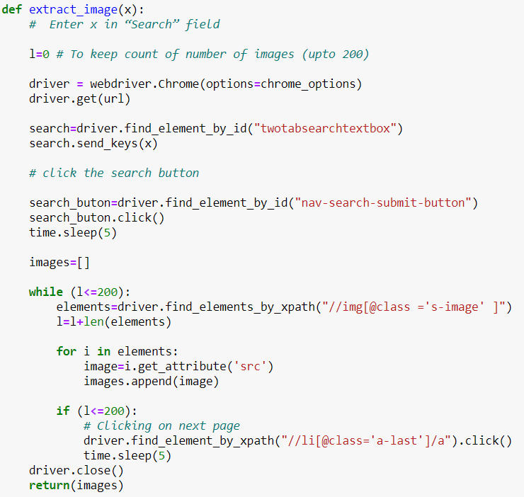
Part 1 - Image Scraping
The task was to search for 200 images of the following categories from amazon website:
The clothing categories used for scraping were:
Sarees (women)
Trousers (men)
Jeans (men)
Function to save the images src attributes which will be used later to download the images to required folders/directories.

Slide 5
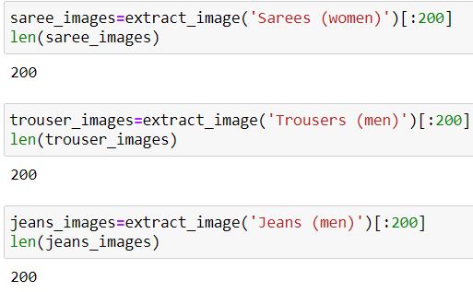
Next, I have called the function with the required search keywords:

Slide 6
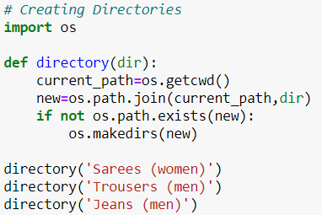
Creating Directories to store images:

Slide 7
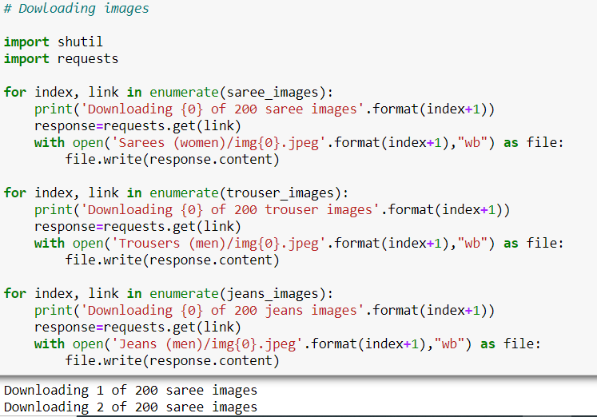
Downloading images to required folders along with download status message:

Slide 8
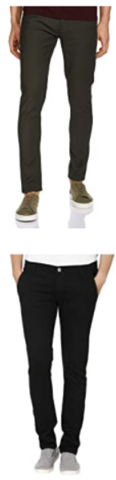
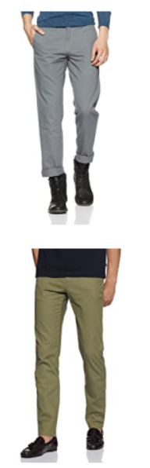
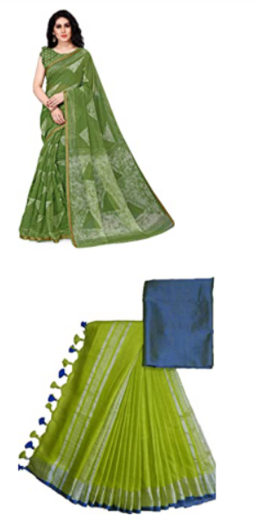
Part 2 – Training Model for Classification
I have created a main folder called 'images' containing 2 folders named 'train' and 'test'. 'train' contains images of each category from 1 to 180 and 'test' contains 181 to 200. I have deleted 1 common picture across all 3 classes which contains a logo

Slide 9
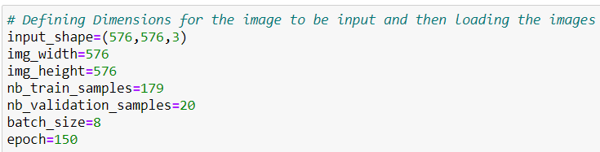
I have defined the image dimensions as below:

Slide 10
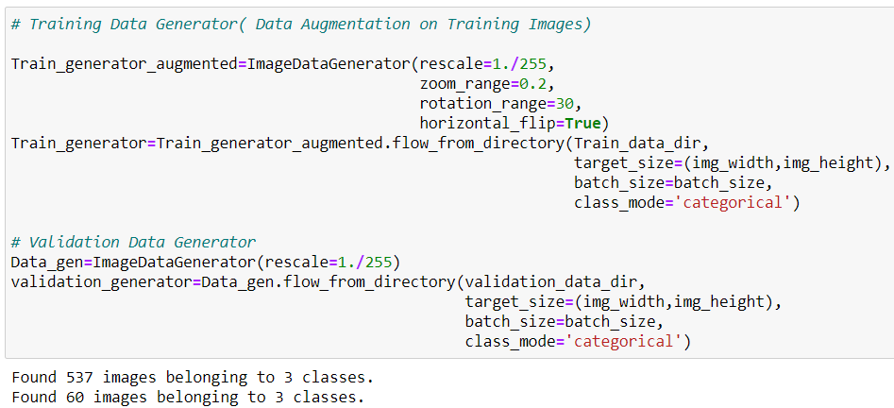
Created Training and Validation sets

Slide 11
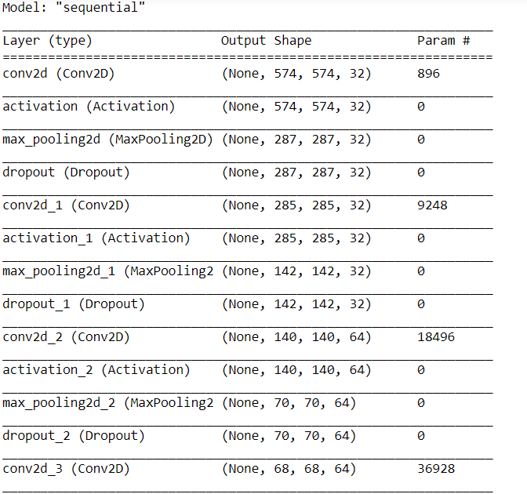
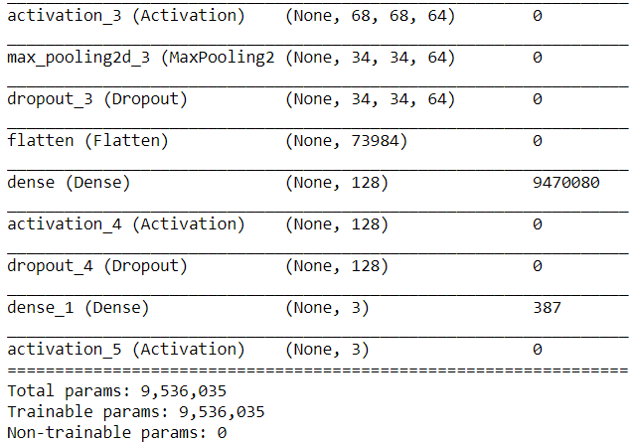
Structure of the Layers used for forward and back propagation:

Slide 12
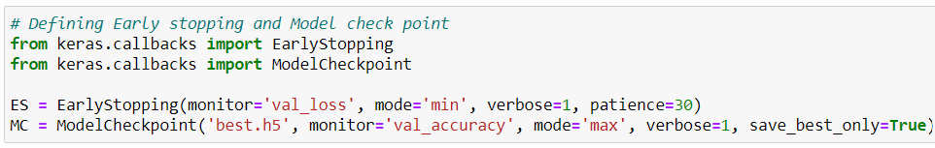
Defined Early Stop criteria and saved the model as ‘best.h5’ for the best results

Slide 13
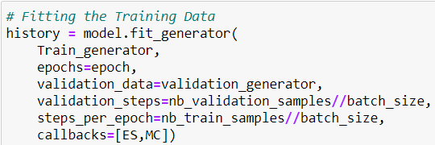
Fitting the Training data with the model

Slide 14
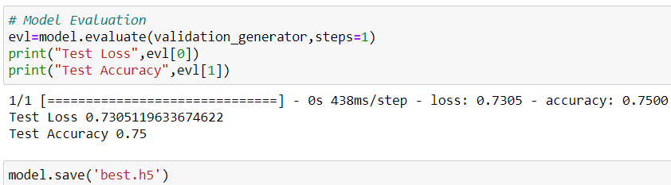
Model Evaluation

Slide 15
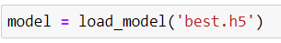
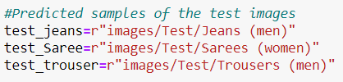
Part 3 – Prediction
Loading saved Model
Loading the required test pictures from the required folder:

Slide 16
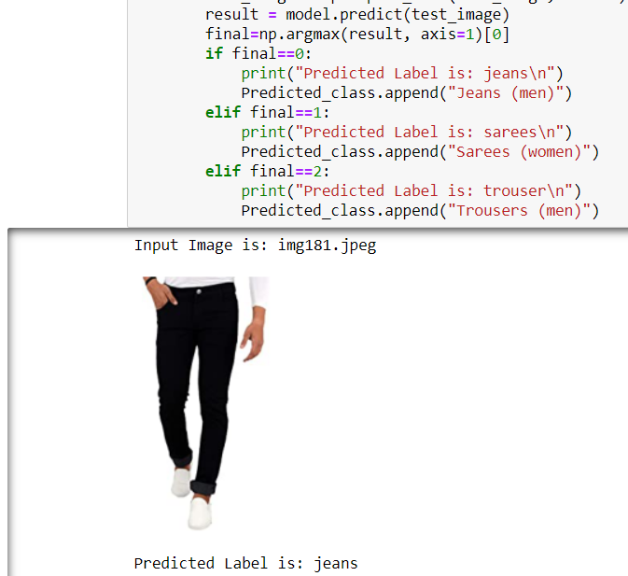
Predicting and displaying prediction as shown below:

Slide 17
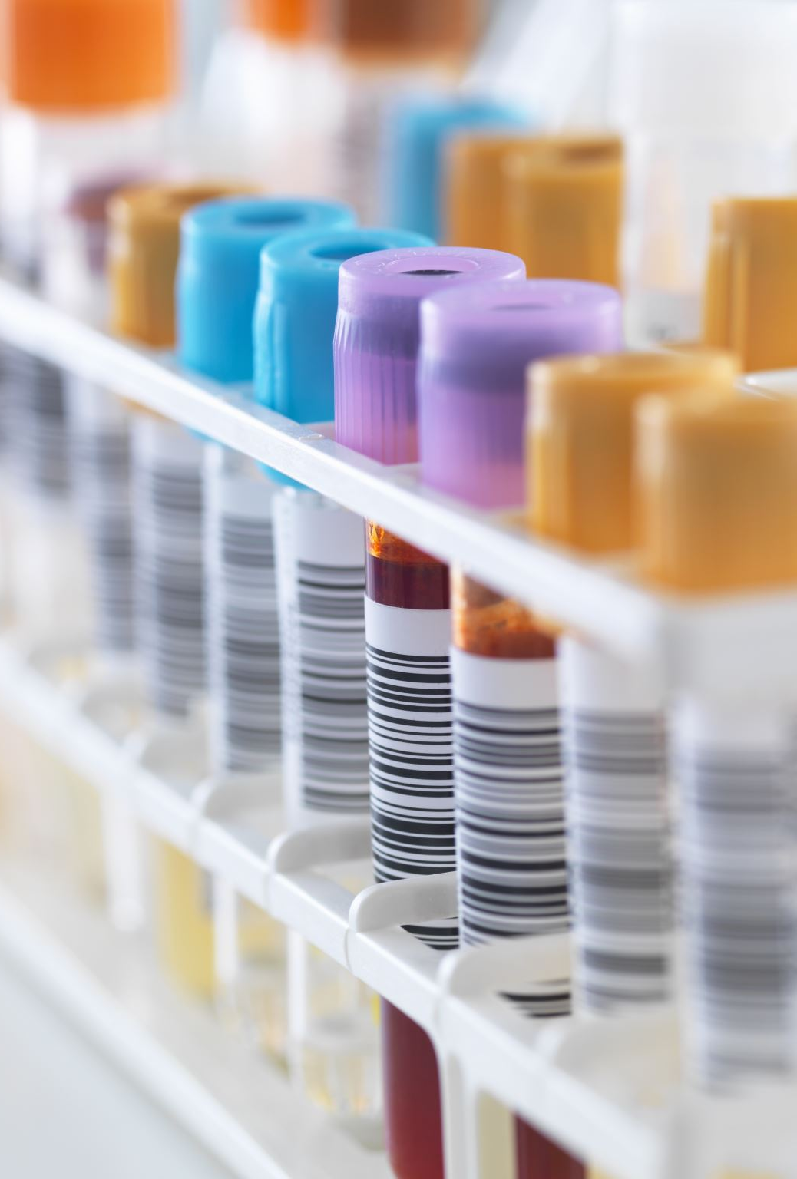
Conclusion:
Model gives a 75% test accuracy.
The accuracy can be enhanced by using more training images. Here, I have used 200 per category which can be increased to 1000 per category to give more training data.

